Slide 1
Design and Analysis of Algorithms
Lecture 1
Mehak Riaz Khan

Slide 2
Online Collaboration
Edmodo – www.Edmodo.com
Class code: 6k9wzc

Slide 3
Course Objectives
Algorithms are the core subject in computer science when it comes to problem solving by computers.
The main objective of this undergraduate level course is to introduce students to the crux of algorithm design, evaluation and implementation.
Famous computer science problems will be discussed and various approaches to the solution would be compared.

Slide 4
Why study this subject?
Efficient algorithms lead to efficient programs.
Efficient programs sell better
Efficient programs make better use of hardware.
Programmers who write efficient programs are more marketable than those who don’t!

Slide 5
Factors influencing program efficiency
Problem being solved
Programming language
Compiler
Computer hardware
Programmer ability
Programmer effectiveness
Algorithm

Slide 6
This course
About performance!
Because, performance is the line between feasible and unfeasible.
E.g. if not fast enough, can not be adopted (fast web search)
This study allows us to develop a theoretical language widely adopted by practitioners, provides a clean way of thinking about algorithms.
Think of performance as currency! You need to have good/enough performance to be able to incorporate other features/specification

Slide 7
Data Structures Review
Data Structure is a way of collecting and organizing data in such a way that we can perform operations on these data in an effective way
A data structure is a way to store and organize data in order to facilitate access and modifications. No single data structure works well for all purposes, and so it is important to know the strengths and limitations of several of them

Slide 8
Data Structures Types
By Size
Static Data Structure
Dynamic Data Structure
By Storage
Primitive Data Structure
Non-Primitive Data Structure
By Nature
Homogeneous Data Structure
Heterogeneous Data Structure
By Access
Linear Data Structure
Sequential Access
Random Access
Non-Linear Data Structure
Hierarchal Access
Group Access

Slide 9
Data Structures Operations
Insertion
Deletion
Searching
Traversal
Sorting
Merging

Slide 10
Algorithms
Well defined steps defined to solve a problem
A well-defined procedure that takes some value or set as input and produces an output.
An algorithm is said to be correct if, for every input instance, it halts with the correct output. We say that a correct algorithm solves the given computational problem

Slide 11
Algorithm Specifications
Every algorithm must satisfy the following specifications...
Input - There should be 0 or more inputs supplied externally to the algorithm.
Output - There should be at least 1 output obtained.
Definiteness - Every step of the algorithm should be clear and well defined.
Finiteness - The algorithm should have finite number of steps.
Correctness - Every step of the algorithm must generate a correct output.

Slide 12
Algorithm Efficiency
An algorithm is said to be efficient and fast, if it takes less time to execute and consumes less memory space.

Slide 13
Performance Analysis
Performance analysis of an algorithm is the process of calculating space required by that algorithm and time required by that algorithm.
The performance of an algorithm is measured on the basis of following properties:
Space Complexity - Total amount of computer memory required by an algorithm to complete its execution is called as space complexity of that algorithm.
Time Complexity - The time complexity of an algorithm is the total amount of time required by an algorithm to complete its execution.

Slide 14
Solving Interesting Problems
Create data structures & algorithms to solve problems.
_{Prove algorithms work}
Buggy algorithms are worthless!
Examine properties of algorithms.
Simplicity, running time, space needed, …
Design
Analysis

Slide 15
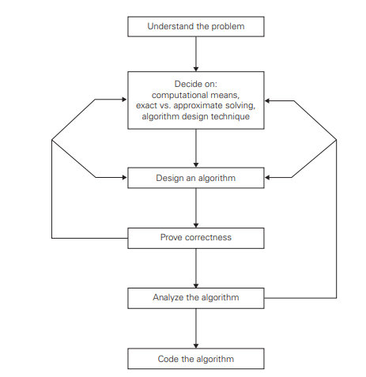
Algorithm Design & Analysis Process

Slide 16
Problems
Decision Problem
Function Problem
Search Problem

Slide 17
Algorithm Descriptions
Algorithms can be described in many forms and ways.
High-level natural language description
Formal description (CS)
Coded form

Slide 18
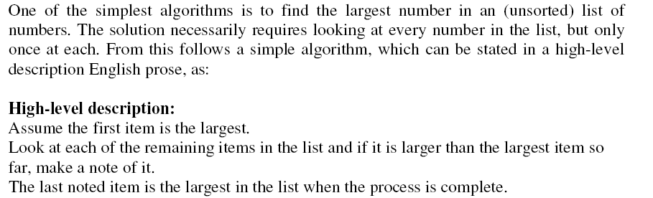
High-level natural language description

Slide 19
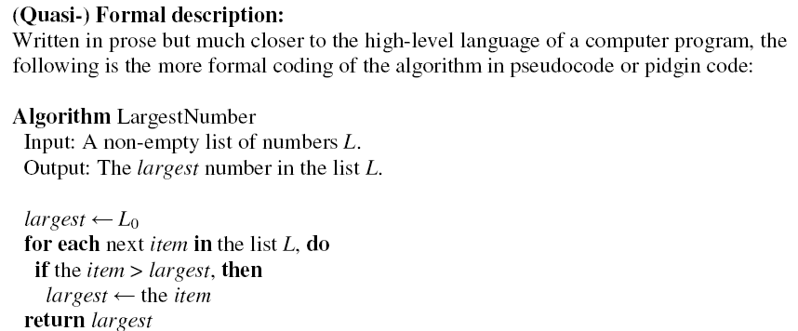
Formal Representation-Pseudo code

Slide 20
Formal Representation-Pseudo code
In the book, typically written in a pseudo code
Very clear
Hides low level details
Not concerned with software engineering issues.

Slide 21
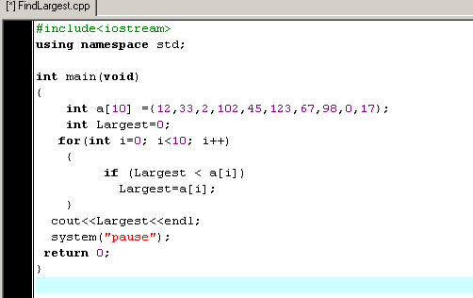
Coded form
In the book, typically written in a pseudo code
Very clear
Hides low level details
Not concerned with software engineering issues.

Slide 22
Growth of Functions
The order of growth of the running time of an algorithm, gives a simple characterization of the algorithm's efficiency and also allows us to compare the relative performance of alternative algorithms

Slide 23
Asymptotic Analysis
Asymptotic analysis of an algorithm refers to defining the mathematical bound/framing of its run-time performance. Using asymptotic analysis, we can very well conclude the best case, average case, and worst case scenario of an algorithm.
Usually, the time required by an algorithm falls under three types:
Best Case - Minimum time required for program execution.
Average Case - Average time required for program execution.
Worst Case - Maximum time required for program execution.

Slide 24
Asymptotic Notation
In asymptotic notation, when we want to represent the complexity of an algorithm, we use only the most significant terms in the complexity of that algorithm and ignore least significant terms in the complexity of that algorithm.
Following are the commonly used asymptotic notations to calculate the running time complexity of an algorithm.
Big Oh Notation, Ο
Omega Notation, Ω
Theta Notation, θ

Slide 25
Big Oh Notation
The notation Ο(n) is the formal way to express the upper bound of an algorithm's running time. It measures the worst case time complexity or the longest amount of time an algorithm can possibly take to complete.

Slide 26
Omega Notation
The notation Ω(n) is the formal way to express the lower bound of an algorithm's running time. It measures the best case time complexity or the best amount of time an algorithm can possibly take to complete.

Slide 27
Theta Notation
Theta notation is used to define the average bound of an algorithm in terms of Time Complexity. It always indicates the average time required by an algorithm for all input values.

Slide 28
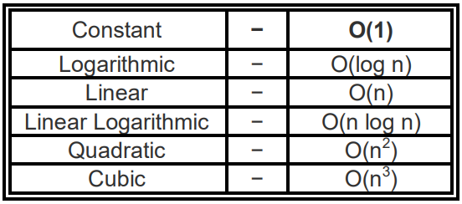
Asymptotic Notations Representation
Following is a list of some common asymptotic notations that represent time complexity

Slide 29
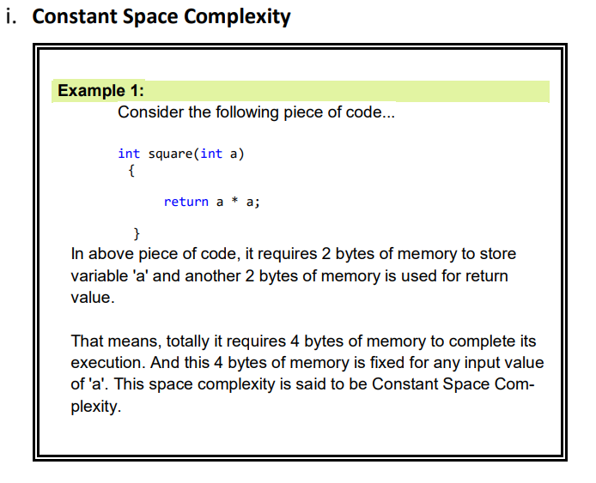

Slide 30
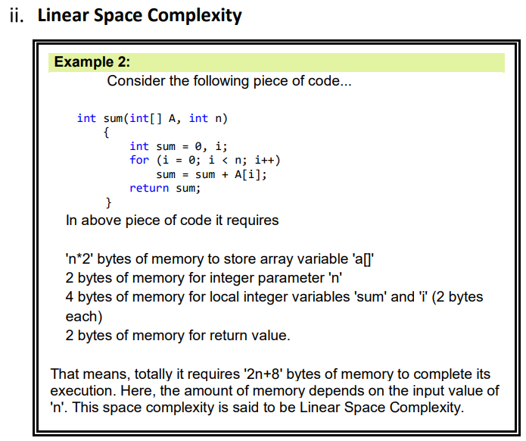

Slide 31
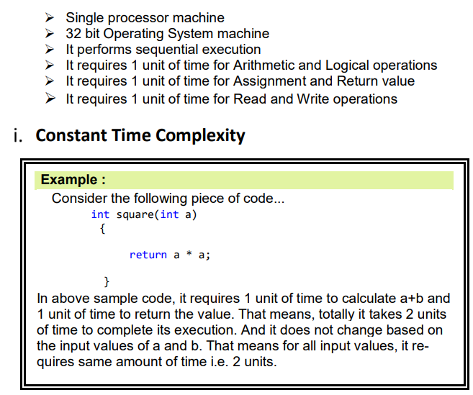

Slide 32
